Slide 1


Lecture 1: Module Introduction
COMP704: Machine Learning
MSc Artificial Intelligence for Games

Slide 2
Today’s session:
Introduction to the module
Introduction to the assignments

Slide 3
Introduction to the module

Slide 4
Introduction to the module
‘Machine Learning’ is an inaccurate title for the module
When we planned it we had two modules:
Symbolic AI
Non-symbolic AI
This reflects what AI is. Marketing made us change them to:
‘Classical AI’ & ‘Machine Learning’ for sales reasons

Slide 5
Introduction to the module
‘Machine Learning’ is an inaccurate title for the module
Symbolic AI
Describes a programming-centric approach to AI
Where you look to analyse and deconstruct problems into solutions that are programs
Non-symbolic AI
Describes a data-centric approach to AI
Hence data science, but data science isn’t ‘all’ of non-symbolic AI
Where you write software to look for patterns in data

Slide 6
Introduction to the module
‘Machine Learning’ is an inaccurate title for the module
Symbolic vs. non-symbolic AI has lead to some interesting issues

Slide 7
Introduction to the module
‘Machine Learning’ is an inaccurate title for the module
Symbolic AI can’t really solve a lot of issues
Tacit / heuristic knowledge & expert systems
Describe how you:
Work out if you know someone from their face
Where to stand to catch a ball
How to drive a car / bike

Slide 8
Introduction to the module
Week 1 | Week 2 | Week 3 | Week 4 | Week 5 | Reading Week
 | Data Science
Introduction | Foundations of Data Science | Intro to ML | ML: Regression | ML: Classification
 | Workshop | Workshop | Workshop | Workshop
 | Paper Club |  | Paper Club |  | Paper Club
Week 7 | Week 8 | Week 9 | Week 10 | Week 11 | Week 12
Genetic Algorithms |  | PCG |  | Genetic Programming
Genetic Algorithms 1 | Genetic Algorithms 2 | Procedural Content Generation 1 | Procedural Content Generation 2 | Genetic Programming 1 | Genetic Programming 2
Workshop | Workshop | Workshop | Workshop | Workshop | Workshop
 | Paper Club |  | Paper Club | Peer Review | Individual Review
Week 13
VIVA OF DOOM

Slide 9
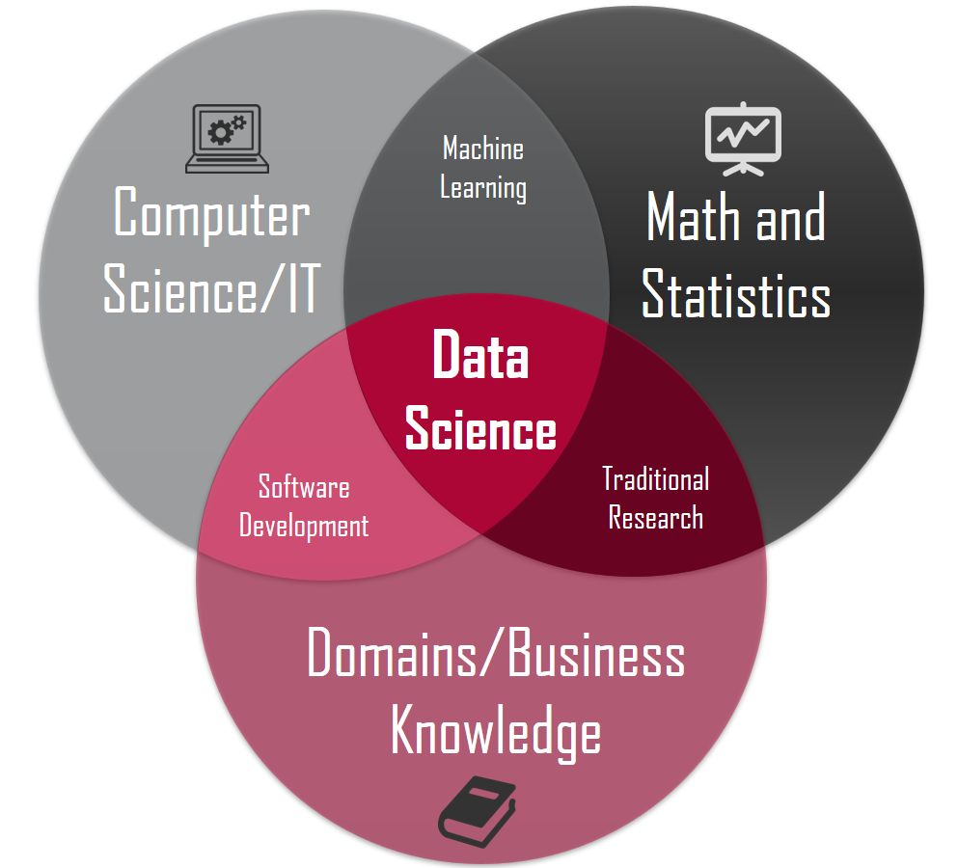
Introduction to the module
Data Science ( & machine learning)
Russel & Norvig:
18. learning from examples
19. Knowledge in learning
20. Learning probabilistic models
21. Reinforcement learning.
https://www.dawsonera.com/abstract/9781292153971

Slide 10
Introduction to the module
Data Science ( & machine learning)
Effectively, using computer science and ‘maths’ to address domain / business problems through the use of data
ML describes a suite of techniques between CS & maths to analyse data
Therefore, it’s clearly data-driven / data-centric
Analytics / metrics (collecting & analysing data)
Relies on
Big data & big processing (not in all cases)
This is why it’s a big thing now

Slide 11
Introduction to the module
Data Science ( & machine learning)
A lot of games orgs will use DS for marketing insights (cf. free-to-play, GaaS, casual games)
Analytics:
Collect user data from players during game play
Upload to a server / AWS
Grind through data looking for ‘business insights’
Where do we lose players?
How can we get players to spend more
What in-game items can we create that players will engage with / buy
How can we make predictions about players & personalise their experiences?

Slide 12

Introduction to the module
Data Science ( & machine learning)
https://medium.com/@t2thompson/tombraider-60682f8fe36f
Where are players dying?
Is there an issues with level design?
Heatmaps (from analytic data) can show this

Slide 13
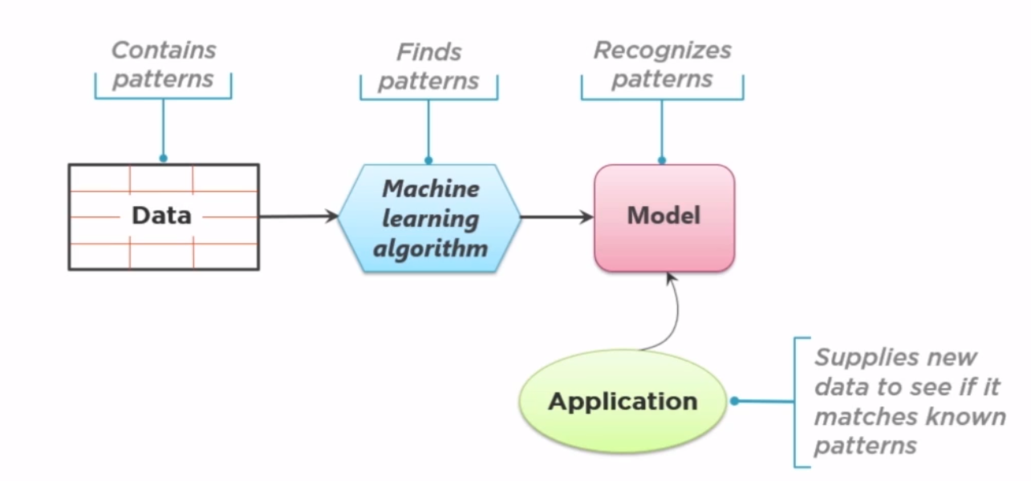
Introduction to the module
Data Science ( & machine learning)
As the name suggests, DS is all about data

Slide 14
Introduction to the module
Data Science ( & machine learning)
Important to remember that ML is just about statistics, we get to define what is good or bad (DS)

Slide 15
Introduction to the module
Data Science ( & machine learning)
Important to remember that ML is just about statistics, we get to define what is good or bad (DS)
DS & ML are not magic bullets
Easy to concentrate on the wrong data

Slide 16
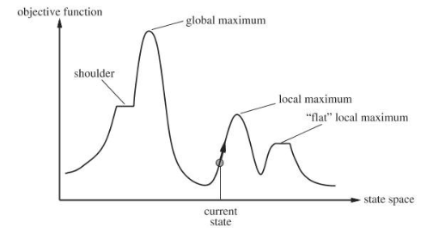
Introduction to the module
Genetic Algorithms
Use Darwinian evolution to perform search space analysis
Russel & Norvig: 4, Beyond classical search
https://www.dawsonera.com/abstract/9781292153971

Slide 17
Introduction to the module
Genetic Algorithms
Q: How do we find global maxima for multi-dimensional quantitative problem spaces?
A: Obviously, make a population of solutions and breed them based on survival of the fittest

Slide 18
Introduction to the module
Genetic Algorithms
Typically:
Store solution attributes as genes in a binary array to simulate a genome
Use the fitness function to evaluate their quality, mate population based on that
Mutate some of the binary bits
Repeat until solution found (best possible or ‘good enough’)

Slide 19
Introduction to the module
Genetic Algorithms
Quantitative assessment is usually key
Input to a complex simulation
Often used to optimise ML & PCG solutions
Can use ‘artist as gardener’ qualitative approach where users can pick or rank population
Particularly useful for qualitative (aesthetic) problems

Slide 20
Introduction to the module
Procedural Content Generation
PCG has a bad name in games as it’s associated with shovel-content
Endless levels for Roguelikes & indie games
No Mans’ Sky bazillion planets of tedium
However, using code to create content can be extremely useful
Asset creation without the need to go to triangle modelling (Probuilder)
Automatic generation of ‘filler’ content for games
Shaker, Togelius & Nelson: Procedural Content Generation in Games
http://pcgbook.com/

Slide 21
Introduction to the module
Procedural Content Generation (Grammar models)
https://www.youtube.com/watch?v=5jBi4KHvnXU

Slide 22
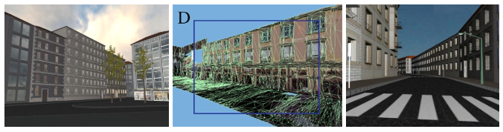
Introduction to the module
Procedural Content Generation
Building & city generation through grammars
http://peterwonka.net/
http://vterrain.org/Culture/BldCity/Proc/
Challenge with this approach is that they are procedural rather than data-driven

Slide 23
Introduction to the module
Procedural Content Generation
Lindenmayer system (L-system)
Mimic nature to create flora through fractals

Slide 24
Introduction to the module
Genetic Programming
John will cover this as the core of his PhD research
Effectively, using genetic approaches (like the GA approach) to create solutions to defined problems
Uses programming constructs (BNF, syntax trees etc)
http://www.genetic-programming.org/

Slide 25
Assignments

Slide 26
Assignments
Application of Machine Learning (70%)
Development Journal (30%)

Slide 27
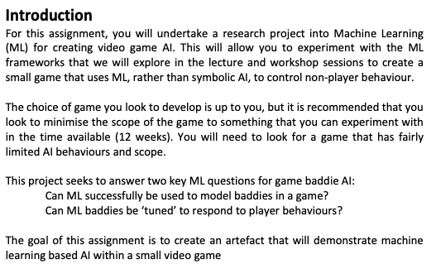
Assignments
Application of Machine Learning (70%)

Slide 28
Assignments
Development Journal (30%)
A week-by-week academic journal of your experiences in creating ML-based AI for a game.
Think of it as a collection of reports detailing your development issues and your attempts to find solutions.
Problems: description & scope
Solutions: synthesis & quality
Writing and diagramming
Further enquiries
Solution reflections

Slide 29
Assignments
We will discuss ideas next week
Ideally:
We’ll use Python for ML
scikit learn
Look to work in Python / PyGame to build your game
Write symbolic AI in python
Use it to generate training data
Build a solution using ML
Evaluate

Slide 30
Assignments
We will discuss ideas next week
Ideally:
Game
Look for something small & simple that you can write in a few hours
Games that you can consider as ‘turn based’ to make it simple to iterate between player and AI, and AI actions
Player does nothing is a valid action ;)
Pong, pacman, asteroids, Space invaders, card games, board games, Tetris etc
Don’t spend forever making a game to then realise it’s not good for training ;)
Getting training data will be key
What will it look like, how will you process it and how do the ML results feed back into the game
Blending results, how to switch between good, bad and indifferent AI play styles

Slide 31
Assignments
We will look at building ML-solutions over the next couple of weeks, in particular pontoon
Don’t forget, the processes you go through to choose a game and develop it are core parts of your development journal

Slide 32
Questions

